Slide 1
Introducing Jenkins

Slide 2



Introducing Jenkins

Slide 3
Introducing Jenkins
ever growing popularity: 100k installations!
used in every sector
software (Yahoo, Google, JBoss/RedHat, HP, Microsoft, …)
telecom (Nokia, Alcatel Lucent, Ericsson, …)
banking
manufacturing
public sector
...

Slide 4
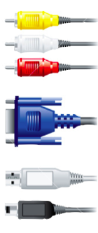



Introducing Jenkins
What makes Jenkins so great?
distributed
builds
reporting
ease of use
extreme
extensibility

Slide 5
Where do we start?
Installing Jenkins
Configuring Jenkins

Slide 6
Installing Jenkins

Slide 7
Installing Jenkins
Download jenkins.war from the website
Run as a stand-alone application
Run in a servlet container
Install system packages (recommended)

Slide 8
Running Jenkins as a stand-alone app
Run from the command line
Uses an embedded application server
Some extra features (restart from the web interface,...)
$ java -jar jenkins.war --httpPort=8081

Slide 9
Running Jenkins as a stand-alone app
Other useful options
--prefix: control context path for reverse proxy
--httpListenAddress: limit interfaces
--logfile: write to a file instead of stdout
--httpsCertificate / --httpsPrivateKey
Signal
Upon SIGALM, log file gets reopened

Slide 10



Running Jenkins on application server
Deploy Jenkins to an existing application server
May fit in better with existing infrastructure
Just deploy the jenkins.war file in the usual manner
jenkins.war

Slide 11
Installing Jenkins on Linux
Native packages are available for the major Linux distributions
Check out the Jenkins web site for detailed instructions
Example for Redhat:
$ sudo wget -O /etc/yum.repos.d/cje.repo \
http://nectar-downloads.cloudbees.com/cje/1.609/rpm/jenkins.repo
$ sudo rpm --import \
http://nectar-downloads.cloudbees.com/cje/1.609/rpm/jenkins-ci.org.key
$ sudo yum install jenkins
$ sudo service jenkins start

Slide 12
More on Linux native packages
Based on stand-alone jenkins.war
Uses an embedded application server
Benefits
Create jenkins users, set up /etc/init.d
Configuration files follow native conventions
Log rotation
Where are files
Settings in /etc/default/jenkins or /etc/sysconfig/jenkins
JENKINS_HOME defaults to /var/lib/jenkins

Slide 13
Installing Jenkins on Windows
Run either:
setup.exe
jenkins.msi if .NET 2.0 runtime is already available
Install Jenkins as a Windows service
All the files go into $JENKINS_HOME
Config file is in $JENKINS_HOME/jenkins.xml
Beware! It gets overwritten

Slide 14
Other installers
MacOSX
pkg file that sets up Jenkins for auto-start upon boot

Slide 15
Runtime requirements
Supported JDKs
OpenJDK 8 or Oracle JDK8
Oracle JDK 7
Basic JVM Memory Sizing
Heap size: -Xms2G -Xmx2G
PermGen on JDK7: -XX:MaxPermSize=256m
G1 garbage collector for heap > 4Gb : -XX:+UseG1GC
System Limits on Linux / Unix
open files
max processes

Slide 16
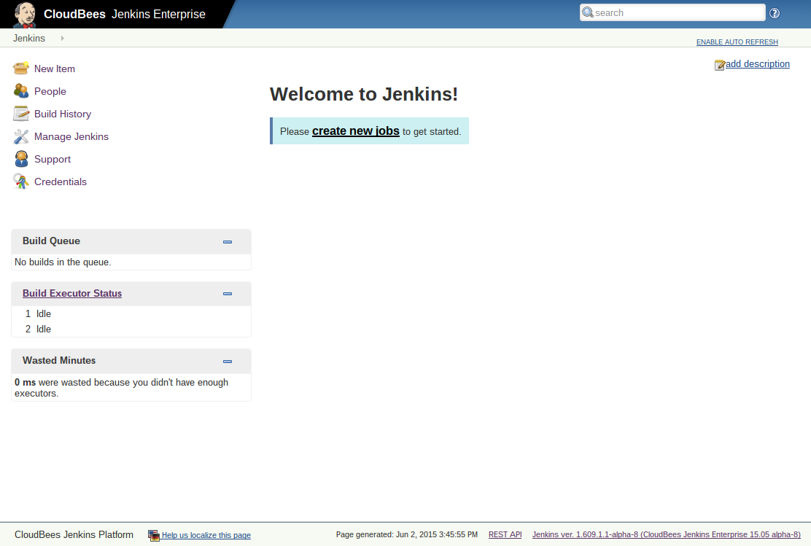
Welcome to Jenkins!

Slide 17
Configuring Jenkins

Slide 18
Jenkins Home Directory
This is where all the important data goes
Need to be backed up, etc.
Can be set in several ways
JENKINS_HOME system property
JENKINS_HOME environment variable
Falls back to ~/.jenkins
Can be verified from system config page

Slide 19
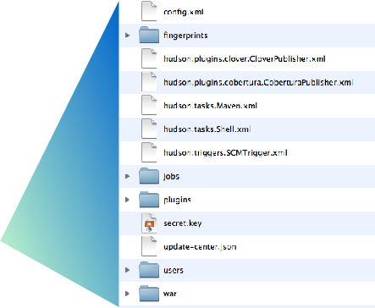
Jenkins Home Directory structure
General configuration file
Build job workspaces, history and artifacts
Installed plugins
JENKINS_HOME
Local user database

Slide 20
Jenkins Home Directory
Prepare for disk usage growth
Especially when you start to host jobs from people who aren’t close to you
Make sure you can throw more disks at the problem later
No need to waste money on 15000rpm SCSI disks
But bigger disk is nice
Can be network mounted (NFS / SAN / CIFS)

Slide 21
Expandable volume
“Spanned volume” on Windows
LVM on Linux
This needs the most upfront planning
ZFS
Shame there’s no viable free Solaris flavor
$JENKINS_HOME should be its own FS
If it’s too late, symlink is your friend

Slide 22
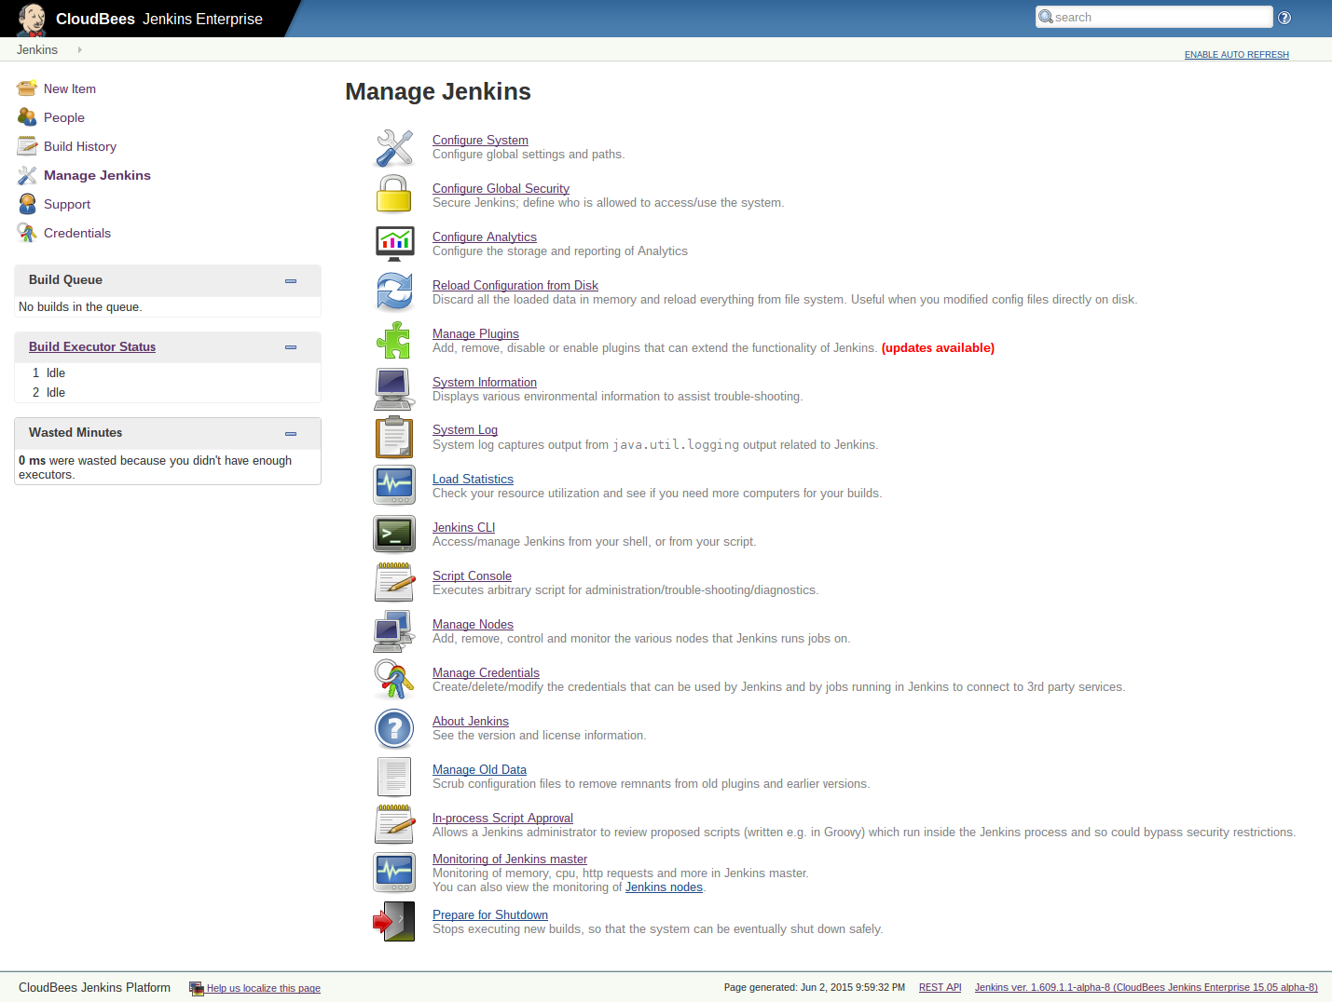
Manage Jenkins

Slide 23
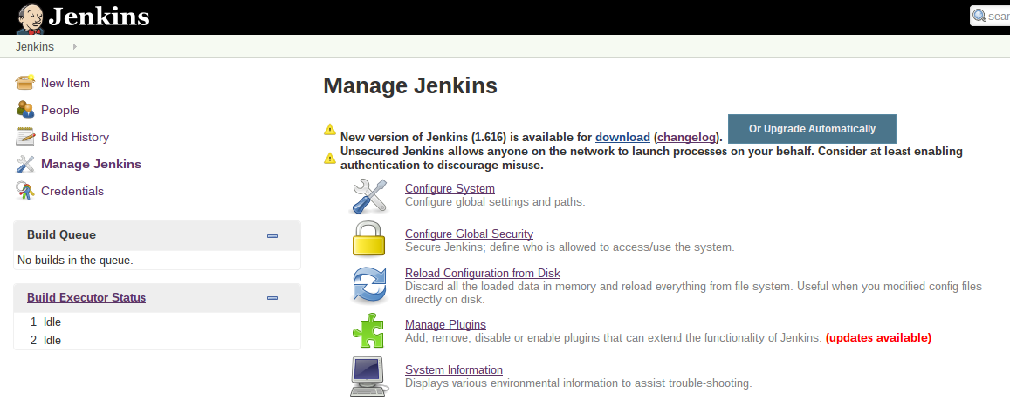
Upgrade of Jenkins
You’ll receive notification when new version is released
Download the latest version and install manually
Or upgrade automatically

Slide 24

System configuration
You can configure many aspects of your Jenkins server:
Security
JDK installations
Build tools - Ant and Maven installations
Version control tools
Email configuration
Plugin-specific configuration

Slide 25
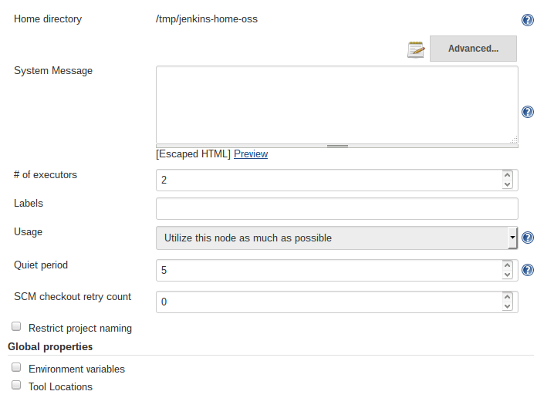
System Configuration: General
Some miscellaneous system parameters

Slide 26
System Configuration: Message
Type arbitrary HTML to show in top page
Often used to describe installation
Pointer to Wiki page, who to contact, etc.
Putting JavaScript is not supported anymore for security reasons

Slide 27
System Configuration: # of Executors
What is ‘Executor’
Unit of task execution on a computer
Defines upper bound of concurrent build execution
Typically, you set this to # of CPU cores
Unless your builds are highly parallel in itself
Watch out for memory requirement

Slide 28
System Configuration: Quiet period
Waits for this many seconds before actually build
Groups related commits together
Originally introduced for CVS
to collapse multiple CVS change notification into one
Still somewhat useful for other SCMs

Slide 29
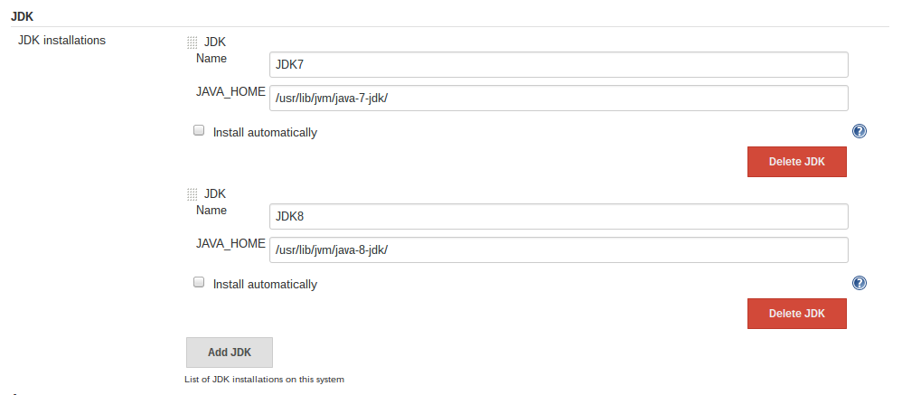
System Configuration: JDKs
Define the JDKs you need for your projects
You can define multiple versions for different projects

Slide 30
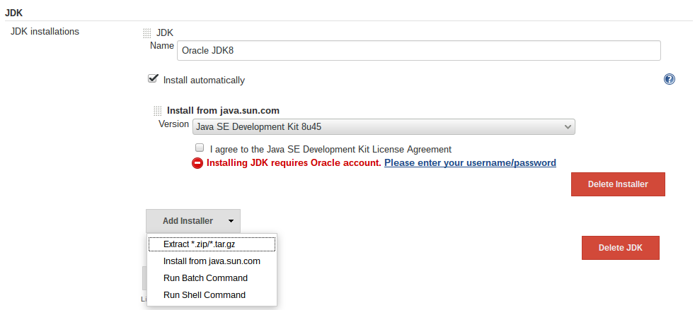
System Configuration: JDKs
Install JDKs automatically
Download from Oracle web site
Or use locally available archive

Slide 31
System Configuration: Build tools
Define the build tools you need to build your projects
By default, Jenkins can use shell, Ant and Maven
You can add many more with plugins
Groovy, Gradle, Grails, sbt, NodeJS …
Many support multiple versions of the tool
Some support auto-installation

Slide 32
System Configuration: SCM tools
Subversion and Git are supported out-of-the-box
Plug-in support for others:
CVS, Mercurial, Perforce, Team Foundation Server, …
Most requires the tools to be separately installed

Slide 33
SCM and authentication
Most SCM tools support/require authentication when talking to servers
How to configure Jenkins depends on SCM
Some can use Credentials plugin (Git, SVN)
CVS
All authentication needs to be done on CLI before use
Make sure to do this from the same user
Perforce
Each project needs you to enter credential separately

Slide 34
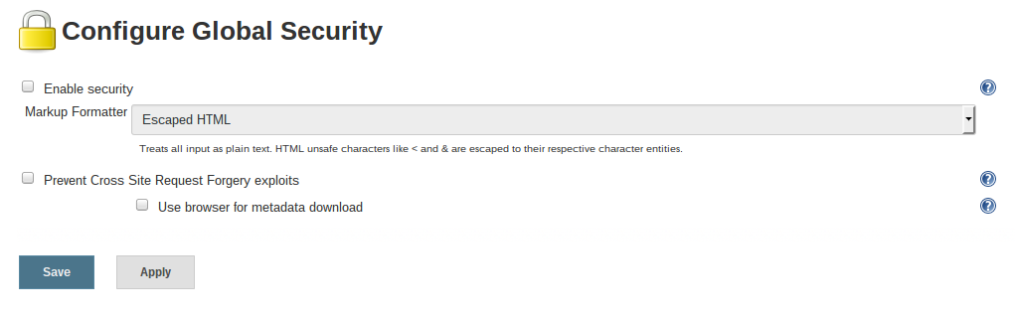
Global Security
Unsecured Jenkins allows anyone on the network to launch processes with Jenkins rights
Consider at least enabling authentication to discourage misuse.
Check to enable

Slide 35
Invest in good URL
If your users can’t see Jenkins, much of the benefit is lost
Make the URL easier to remember
Bad: http://tjek-02.int.rev.example.org
Good: http://jenkins.example.org

Slide 36
Use name service
Get the host alias, instead of using primary machine name
If your IT isn’t helping, use dynamic DNS
This also makes your service relocatable

Slide 37

No “/jenkins”
Use virtual host to distinguish multiple apps, not context path
http://jenkins.example.org
http://jira.example.org

